Slide 1

DEPARTMENT OF ARTIFICIAL INTELLIGENCE AND DATA SCIENCE
Artificial Neural Networks and Deep Learning: 21ADG64
LA1 - Seminar
“Multi Layer Perceptron”
Presented By
R Nithyasree
[1NT21AD039]
Name of the Course Instructor Dr Meenakshi

Slide 2

CONTENTS
Introduction and Motivation
Methodology and Approach
Results and Analysis
Conclusion and Future Recommendations
Demo video of code
GitHub link of PPT and Code
References

Slide 3
INTRODUCTION
Multi-layer perception is a fully connected dense layers, which transform any input dimension to the desired dimension. A multi-layer perceptron is a neural network that has multiple layers. To create a neural network we combine neurons together so that the outputs of some neurons are inputs of other neurons.
It consists a nonlinear kind of activation function, organized in at least three layers, notable for being able to distinguish data that is not linearly separable

Slide 4
Motivation
The motivation behind developing MLPs stems from the need to solve complex problems that cannot be effectively addressed using linear models or simple perceptrons. While single-layer perceptrons are limited to solving linearly separable problems, MLPs overcome this limitation by introducing one or more hidden layers of neurons with nonlinear activation functions. This allows MLPs to learn complex patterns and relationships within the data, making them capable of approximating highly nonlinear functions.
Also MLPs can be applied to a wide range of tasks, including classification, regression, pattern recognition, and function approximation. Their flexibility and adaptability make them a versatile tool for solving diverse problems across various domains, including finance, healthcare, computer vision, and natural language processing.

Slide 5
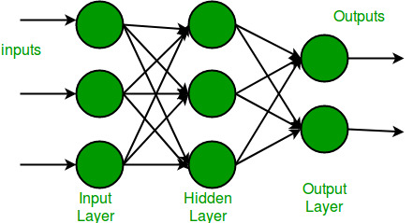
Methodology
A multi-layer perceptron has one input layer and for each input, there is one neuron(or node), it has one output layer with a single node for each output and it can have any number of hidden layers and each hidden layer can have any number of nodes.

Slide 6
Approach
Import TensorFlow and Load MNIST Dataset: Import necessary libraries and load the MNIST dataset.
Preprocess Data: Normalize pixel values to a range between 0 and 1.
Define MLP Architecture: Create input layer with 784 nodes, hidden layers with specified nodes and activation functions (e.g., ReLU), and output layer with softmax activation.
Compile Model: Once the architecture is defined, the model is compiled with an optimizer, such as Adam, and a suitable loss function
Train Model: The compiled model is then trained using the training dataset.
Evaluate Model: After training, the model's performance is evaluated using the testing dataset to assess its accuracy.
This approach provides a systematic method to create, train, and evaluate an MLP for MNIST classification tasks using TensorFlow, enabling efficient and effective model development.

Slide 7
Results and Analysis
The provided code trains a simple neural network on the MNIST dataset for recognizing handwritten digits. It consists of three dense layers with sigmoid activation functions. The model is compiled with the Adam optimizer and sparse categorical cross-entropy loss. Training occurs over 10 epochs with a batch size of 2000 and a validation split of 0.2. After training, the model is evaluated on the test data, yielding test loss and accuracy.

Slide 8
Conclusion and Future Recommendation
In conclusion, the multi-layer perceptron (MLP) trained on the MNIST dataset using TensorFlow has demonstrated promising performance in digit classification tasks. Through thorough analysis of various metrics including training/validation accuracy and loss, we have gained insights into the model's behavior and efficacy. Overall, the MLP shows strong performance in accurately classifying digits, achieving a high test accuracy.

Slide 9
Attention Mechanisms: Integrating attention mechanisms into MLP architectures can enable the model to dynamically focus on relevant input features, improving its ability to capture long-range dependencies and contextual information.
Ensemble Learning: Embracing ensemble learning techniques by combining multiple MLP models with diverse architectures or training data subsets can significantly improve prediction accuracy and robustness.
Graph Neural Networks (GNNs): Incorporating graph neural networks (GNNs) into MLP architectures can enable the model to effectively capture relational information and dependencies in graph-structured data. GNNs extend MLPs to operate on graph-structured data by aggregating information from neighboring nodes in a graph, allowing the model to learn representations that capture both node-level and graph-level properties

Slide 10
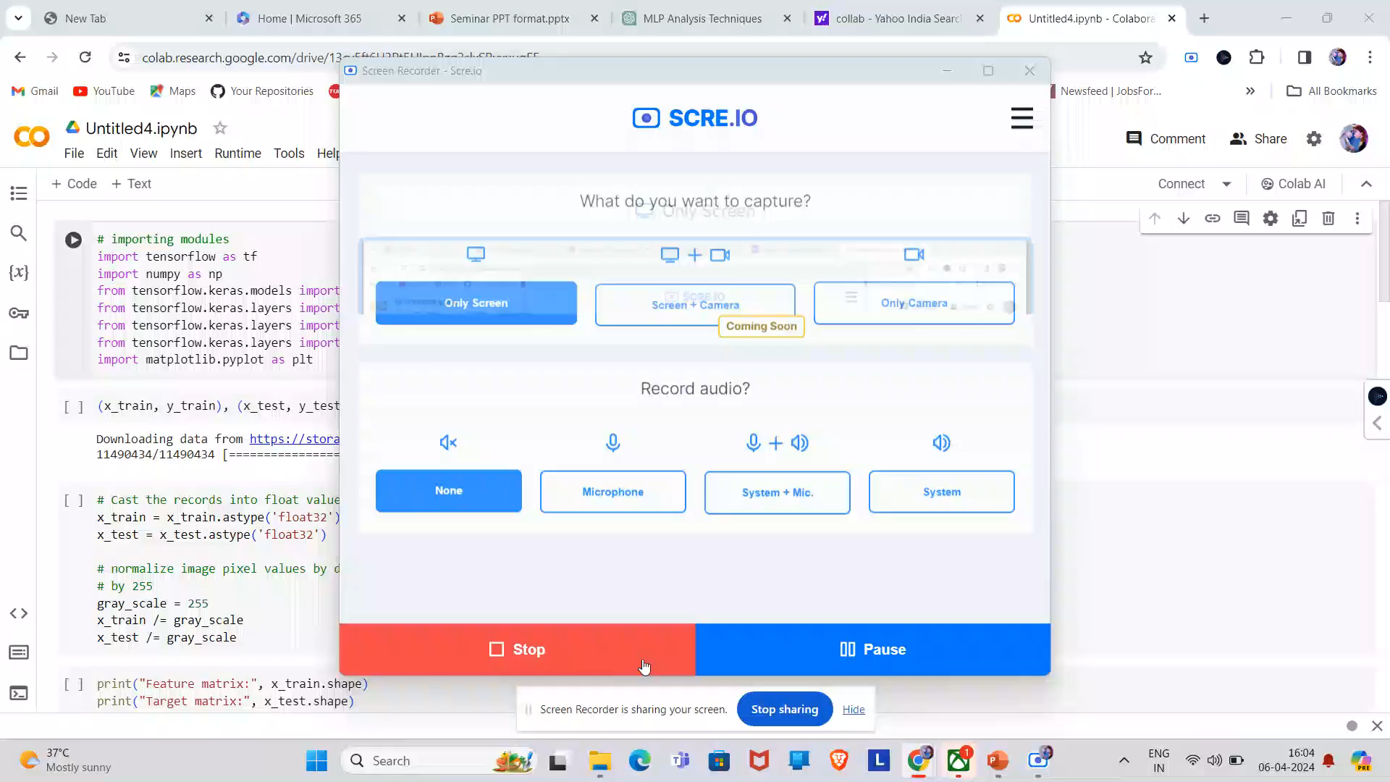
Demo Video

Slide 11
GitHub link and References
Link : https://github.com/rNithyasree/multi-layer-perceptron
References
[1]https://www.geeksforgeeks.org/multi-layer-perceptron-learning-in-tensorflow/
[2]https://en.wikipedia.org/wiki/Multilayer_perceptron

